Slide 1

Software Engineering Lecture # 3
Quratulain
Lecturer
Department of Computer Science

Slide 2
Objectives
To introduce Software Development Life Cycle
To discuss various phases of Software Development Life Cycle

Slide 3
Software Development Life Cycle
Software Development Life Cycle, SDLC for short, is a well-defined, structured sequence of stages in software engineering to develop the intended software product.
SDLC provides a series of steps to be followed to design and develop a software product efficiently.

Slide 4

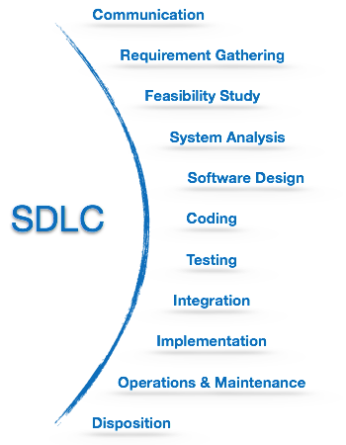
Software Development Life Cycle(Cont..)

Slide 5
Communication
This is the first step where the user initiates the request for a desired software product.
Involves communication among the customer and other stake holders; encompasses requirements gathering.
The user contacts the service provider and tries to negotiate the terms, submits the request to the service providing organization in writing.

Slide 6
Modelling: Software Requirements Analysis
Helps software engineers to better understand the problem they will work to solve
Encompasses the set of tasks that lead to an understanding of what the business impact of the software will be, what the customer wants, and how end-users will interact with the software
Uses a combination of text and diagrams to depict requirements for data, function, and behavior
Provides a relatively easy way to understand and review requirements for correctness, completeness and consistency
6

Slide 7
Requirement Gathering
The team holds discussions with various stakeholders from problem domain and tries to bring out as much information as possible on their requirements.
The requirements are contemplated and segregated into user requirements, system requirements and functional requirements.
Notes:
Contemplated- anticipated
Segregated- keep apart

Slide 8
Requirement Gathering(Cont..)
studying the existing or obsolete system and software,
conducting interviews of users and developers,
referring to the database
collecting answers from the questionnaires.

Slide 9
Feasibility Study
After requirement gathering, the team comes up with a rough plan of software process.
At this step the team analyzes if a software can be designed to fulfill all requirements of the user, and if there is any possibility of software being no more useful.

Slide 10
Feasibility Study (Cont..)
It is also analyzed if the project is financially, practically, and technologically feasible for the organization to take up.
There are many algorithms available, which help the developers to conclude the feasibility of a software project.

Slide 11
Feasibility Study (Cont..)
There are mainly five types of feasibilities checks:
Economic: Can we complete the project within the budget or not?
Legal: Can we handle this project as cyber law and other regulatory framework/compliances.
Operation feasibility: Can we create operations which is expected by the client?
Technical: Need to check whether the current computer system can support the software
Schedule: Decide that the project can be completed within the given schedule or not.

Slide 12
Planning
Establishes a plan for software engineering work; addresses technical tasks, resources, work products, and work schedule

Slide 13
System Analysis
At this step the developers decide a roadmap of their plan and try to bring up the best software model suitable for the project.

Slide 14
System Analysis(Cont..)
System analysis includes understanding of software product limitations, learning system related problems or changes to be done in existing systems beforehand, identifying and addressing the impact of project on organization and personnel etc.

Slide 15

System Analysis(Cont..)
The project team analyzes the scope of the project and plans the schedule and resources accordingly.

Slide 16
Questions
Any Question Please?
You can contact me at: quratulain@uosahiwal.edu.pk
Your Query will be answered within one working day.

Slide 17
Further Readings
Software Engineering: Parishioner's Approach, Chapter 1.
New Software Engineering by Sue Conger, Ch. 1

Slide 18
Thanks

